Slide 1
A walk through Reinforcement Learning
Baani Leen Kaur Jolly

Slide 2
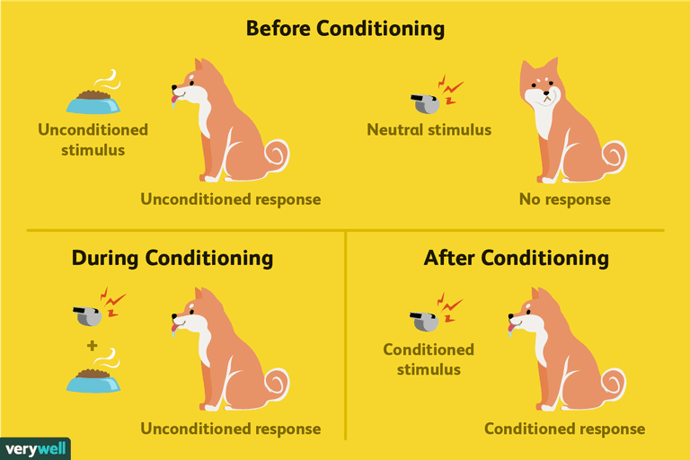
Classical Conditioning
Notes:
Reinforcement of CC by repitition

Slide 3
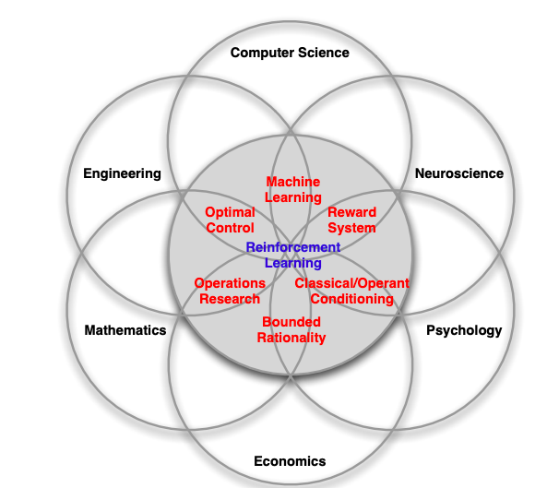

Slide 4
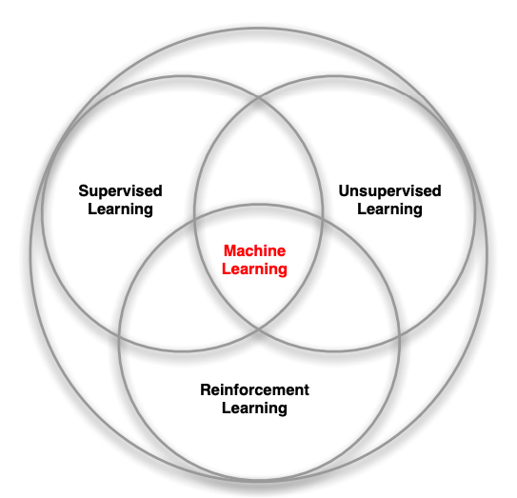
Machine Learning

Slide 5


Machine Learning
Supervised Learning Classification
Unsupervised Learning Clustering
Reinforcement Learning Closest to human behaviour.
Learns the optimal policy on how to act in a given environment

Slide 6
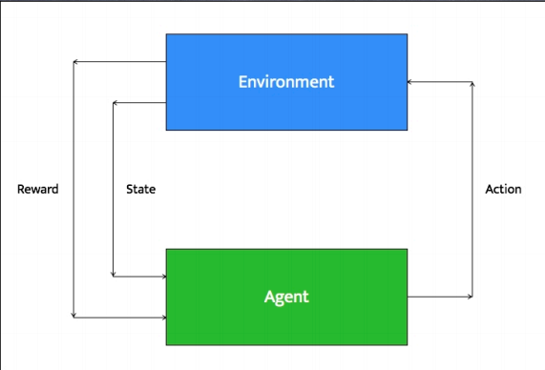
RL Environment
Notes:
We basically design the agent and teach it how to learn the optimal policy - that is what RL is about.
So, in the typical RL environment, we have an agent, who given an environment state, takes an action,which leads to a change in the environment state, and the environment now returns to it a reward which tells how good this move is wrt to reaching our final destination, and the next environment state. Thus based on the rewards it gets, it learns the optimal moves and stores it as a decision making function called a policy.

Slide 7
Terminology through an Example
Maze
Agent - The person trying to find a way through the maze
Environment - The maze
State - Each of the nxn grid blocks in the maze
Action - Up, down, left, right
Rewards - Immediate Reinforcement received
Value Function - Long term reinforcement received
Policy - The decision function, through RL we aim to learn the optimal policy

Slide 8
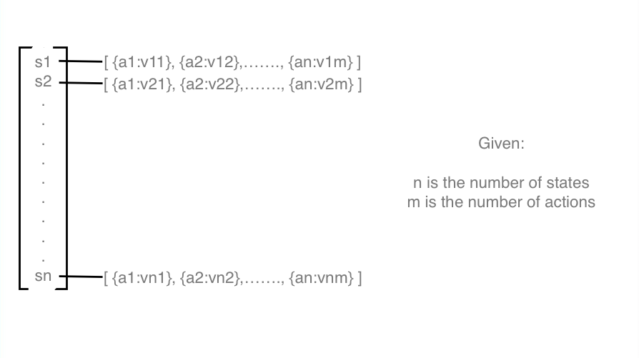
Notes:
Initially the agent has the reward set to 0 for every state action pair.
The agent gets the environment state, the reward(which is initially 0) and then takes a decision as to which actions to take out of the m actions possible to maximise the reward. Every action has an impact in the environment which thus provides the rewards.

Slide 9
Reward function vs Value function
Example 1 : A Maze
Reward: ?
Value Function: ?

Slide 10
Reward function vs Value function
Example 2 : Tic Tac Toe
Reward: ?
Value Function: ?

Slide 11
Steps in RL
Creating or modelling the environment
Defining agent, states and actions
Defining the learning algorithm

Slide 12
Q Learning Algorithm
Given: State diagram (R matrix)
Set parameters and environment
Initialize Q matrix as zeros
For each iteration :
Select random initial state
Do while not reach goal state
Select one among all possible states
Using possible action, go to next state
Get maximum Q value based on R value and update Q-table
Set the next state as current state

Slide 13

Do
Select an action a and execute it
Receive immediate reward r
Observe new state s_{o}
Update each table entry for ˆQ(s, a) as follows
Change state

Slide 14
Hyperparameters
Learning Rate:
Why need it?
How to decide it’s value?
Exploration vs Exploitation?
Epsilon greedy approach

Slide 15
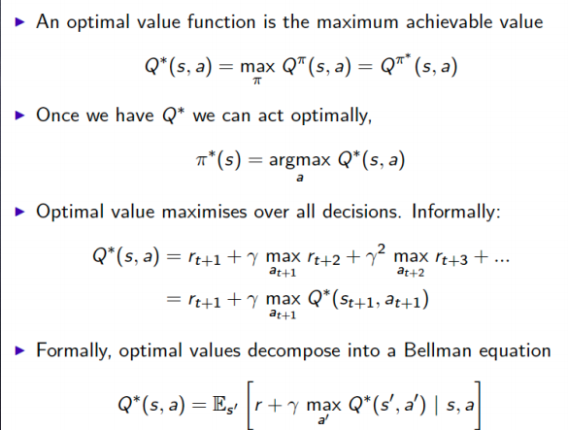
Bellman Equation

Slide 16
Demo

Slide 17
References
https://docs.google.com/viewer?a=v&pid=sites&srcid=aWlpdGQuYWMuaW58YWkyMDE4fGd4OjEwY2E4ZGIyZTM3YTQwNjk
http://www0.cs.ucl.ac.uk/staff/d.silver/web/Teaching_files/intro_RL.pdf
Various online resources

